Slide 1

MEROS3D
3D digitization and interactive display platform for museum exhibits
Javohir Qosimov
3D Artist
01

Slide 2

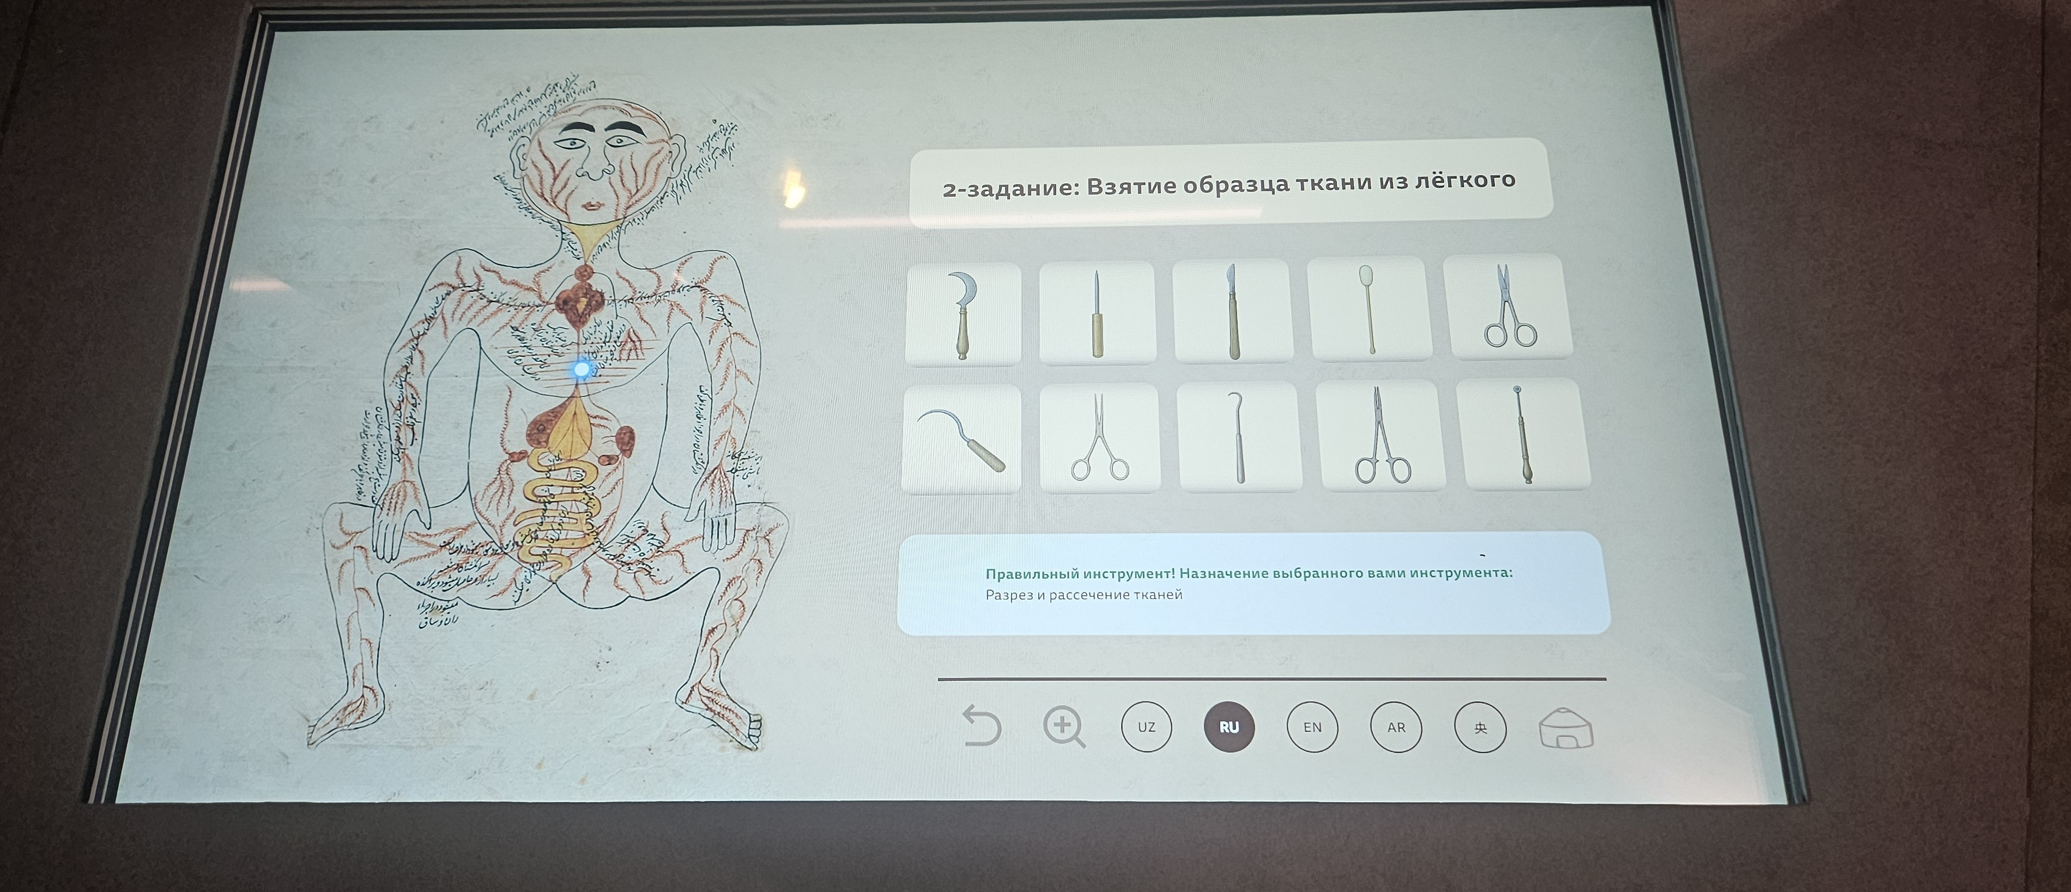
The Problem
Museums today aren't interactive enough for the modern visitor
Static Displays
Existing museum screens only show images or PDF files — there's no interactivity.
Display Case Limits
Visitors can only view exhibits from one angle behind glass — the back and fine details stay hidden.
One angle only, no way to interact
A real museum screen: just images and text, nothing you can rotate
02

Slide 3


The Solution
Meros3D — a digital platform that brings exhibits to life
Meros3D Platform
3D Viewer software built for touchscreen kiosks and web browsers.
Full Interactivity
Rotate exhibits a full 360° with a finger, zoom in, and pan around.
Multilingual Interface
Switch instantly between UZ, RU, EN, and AR with a single tap.
03

Slide 4

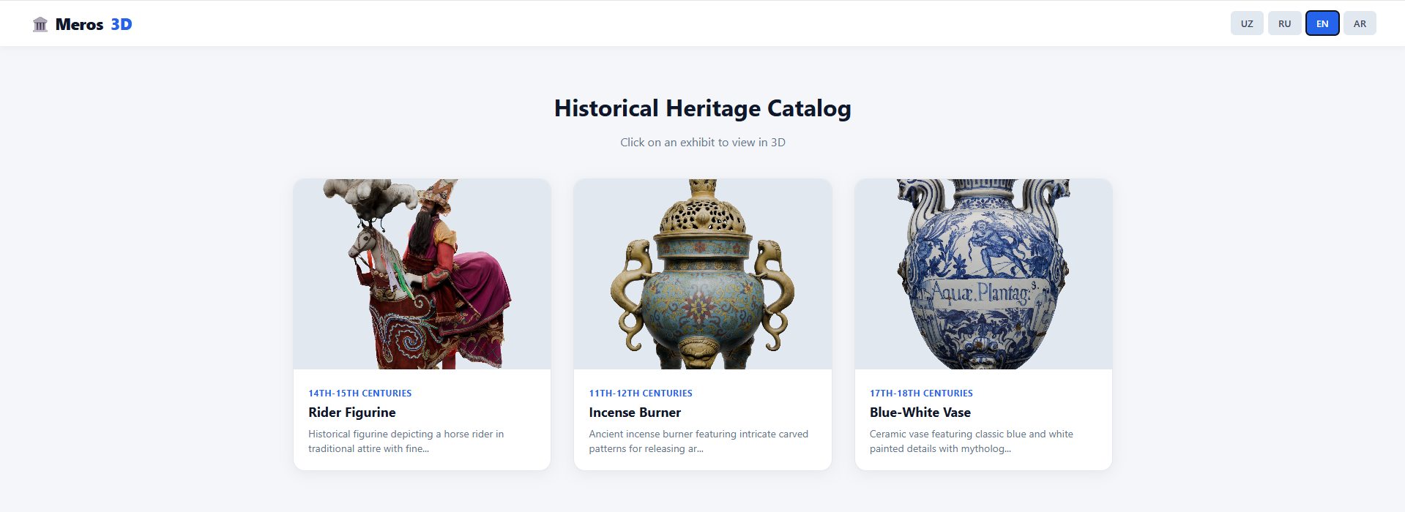

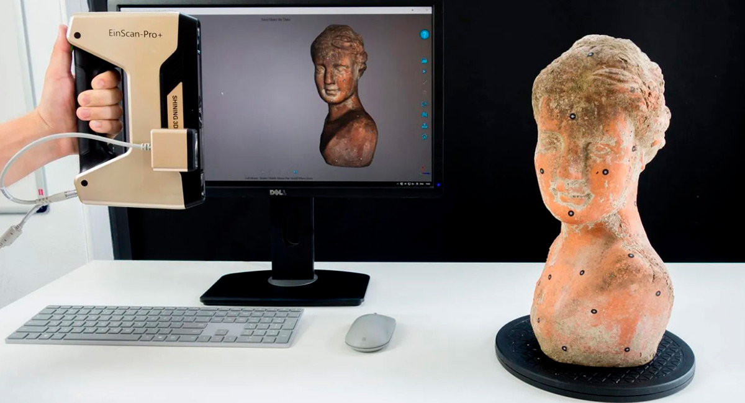
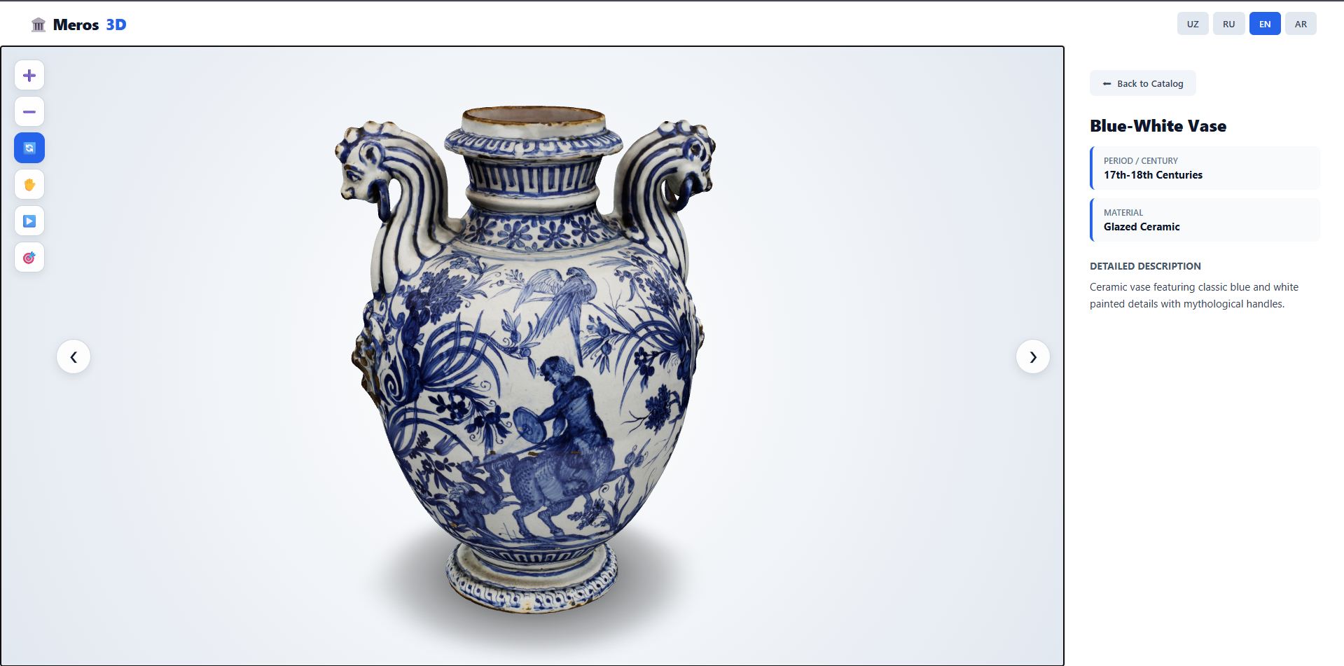
Product & MVP
meros3d.uz — Catalog
Working MVP
A working 2-page (Catalog + 3D Viewer) web platform.
High Optimization
Photogrammetry means 3D models load fast and keep realistic texture detail.
meros3d.uz — 3D Viewer: Aquæ Plantag Vase
The 3D photogrammetric scanning process
04

Slide 5

Business Model
One-Time Payment
Monthly Subscription
Setup & Scanning
SaaS
$80–$150
$50–$100
per exhibit for 3D scanning
per month
$300–$500
Technical support
System updates
Ongoing addition of new exhibits
for platform setup
05

Slide 6



Market & Advantage
100+
1,000+
Expansion
Adaptable to jewelry stores, architecture, and private galleries.
museums in Uzbekistan
cultural heritage objects
Competitive Edge
National heritage in the digital age
Uzbekistan's rich historical and cultural heritage creates a large, growing market for Meros3D.
Works in any browser — no expensive dedicated hardware or OS required.
06

Slide 7
Roadmap
Q1
Q2
Q3
Pilot Testing
Scanner Purchase
Commercial Contracts
1
2
3
Run 14-day free pilot tests in museums and collect feedback.
Purchase a professional 3D scanner and triple the scanning speed.
Sign initial commercial contracts with museums in Tashkent and Samarkand.
07

Slide 8

The Ask & Team
The Ask
Team
Acceptance into the IT Park incubation program, plus mentorship
$6,000
Javohir Qosimov
3D Artist
Grant — for purchasing a professional 3D scanner
Specialist in modeling, texturing, and the 3D production pipeline.
08

