Slide 1
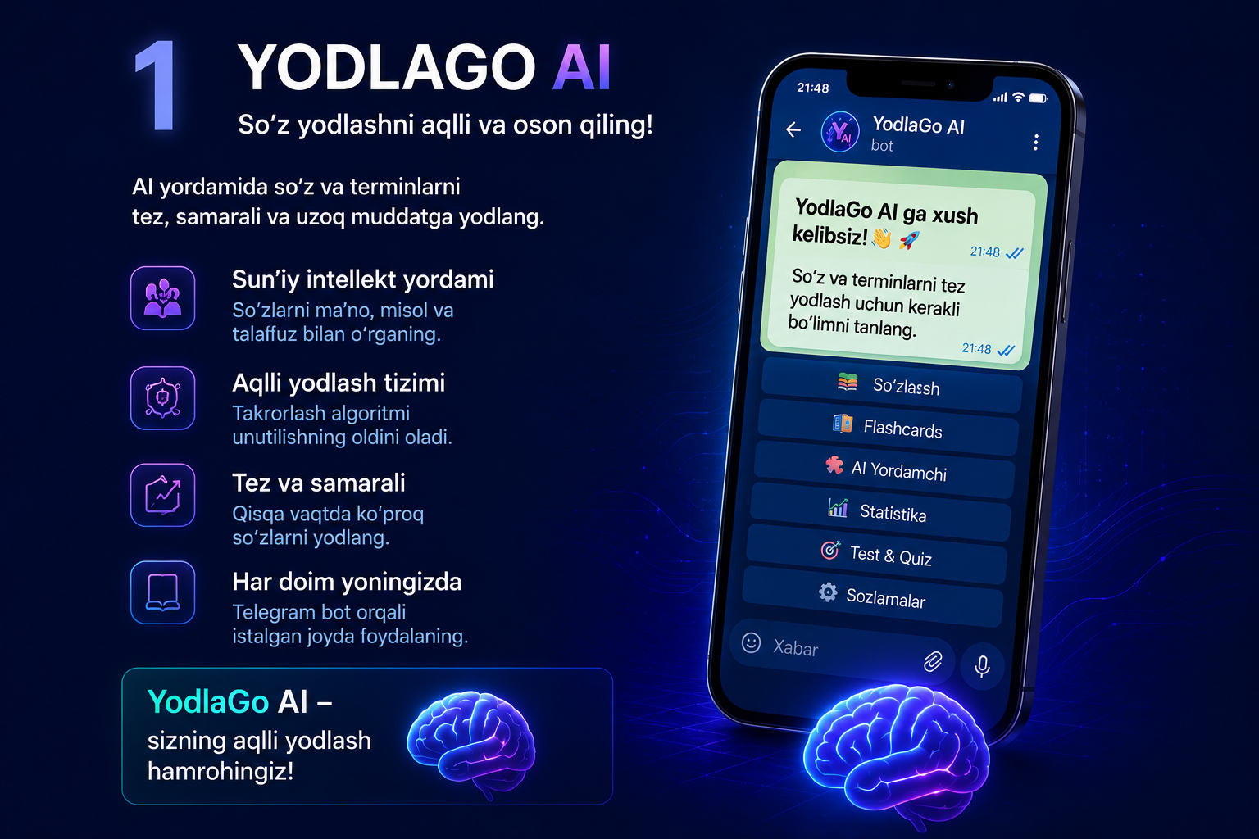

Slide 2
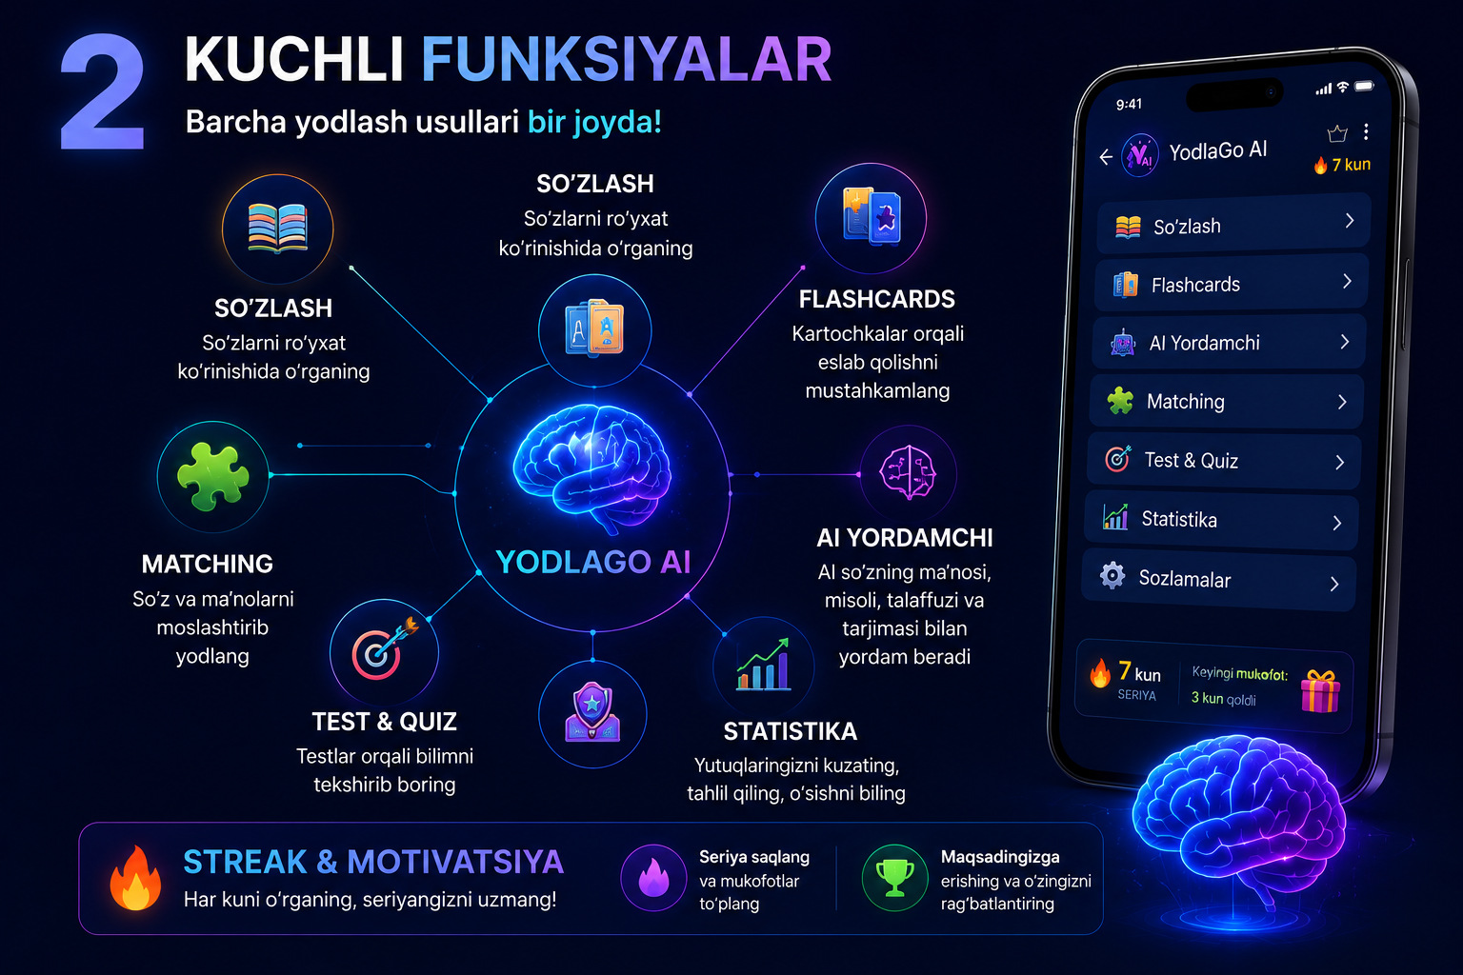

Slide 3
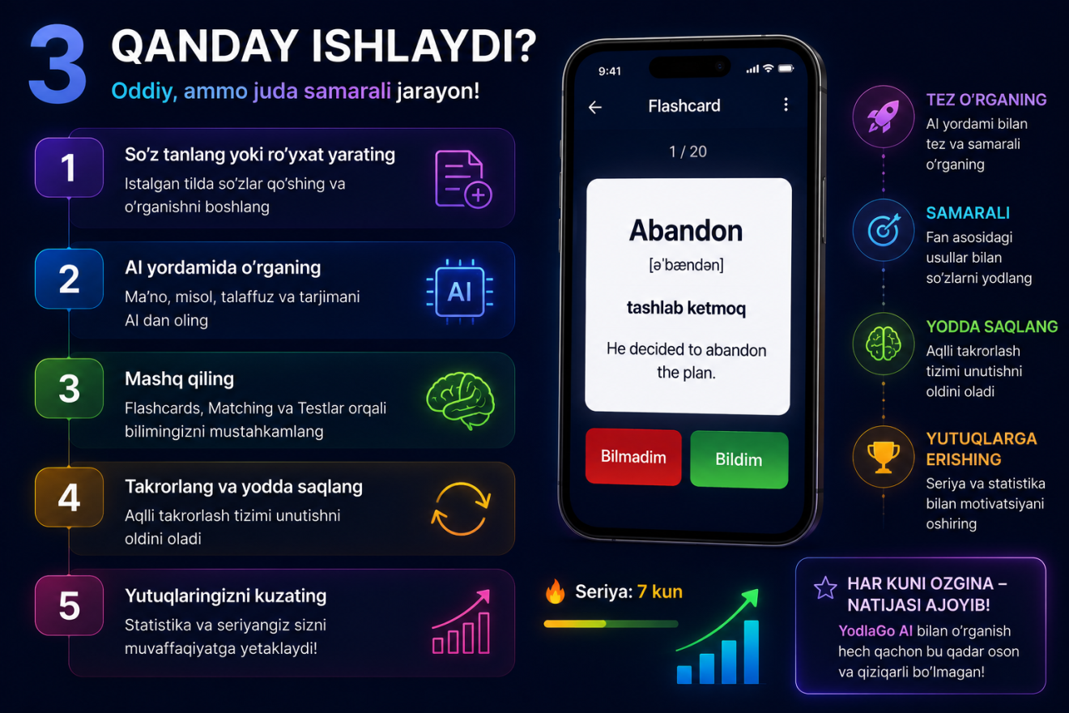

Slide 4
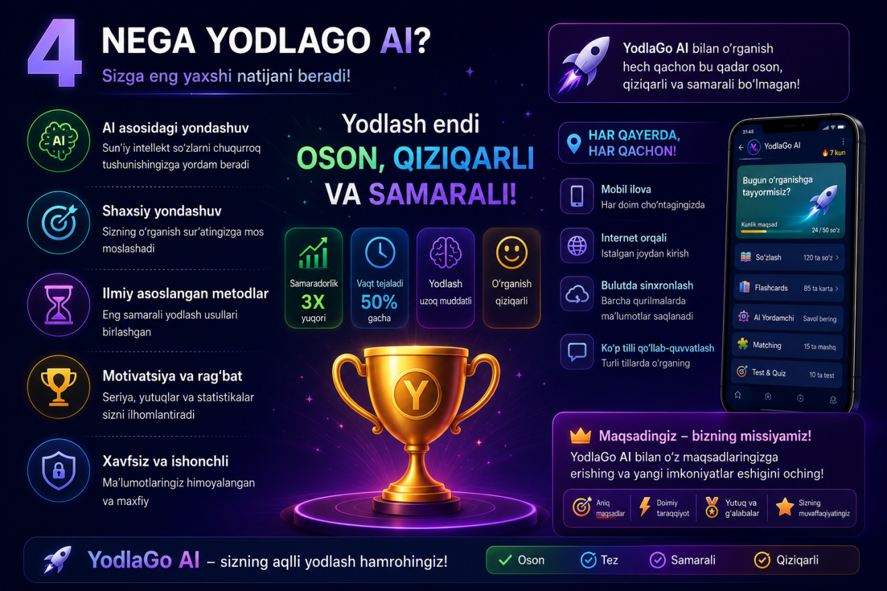

Slide 5
YodlaGo AI bot
Jamoa a’zolari;
1. Murtozayev Nomozbek - Founder&project developer
2. Murtozayev Anvarjon - Assistant project developer
Biznes model; B2C ( monthly subscription/ advertising

