Slide 1

Logivo
01 / 12
PRODUCT PRESENTATION
Freight moves.
You stay in control.
Logivo is a mobile logistics marketplace: clients publish loads, drivers bid, and every trip is tracked live — from pickup to delivery.
2
Roles
Live
GPS
TG
Auth
UZ
Market

Slide 2

Logivo
02 / 12
THE PROBLEM
Cargo markets are still fragmented
Calls, chats, and spreadsheets leave gaps in pricing, trust, and visibility once a truck is on the road.
Opaque matching
Reliable trucks and loads still depend on personal networks.
Blind execution
Clients lose the trip after departure — no shared live map.
Weak trust layer
Docs, ratings, and payments live in separate tools.

Slide 3
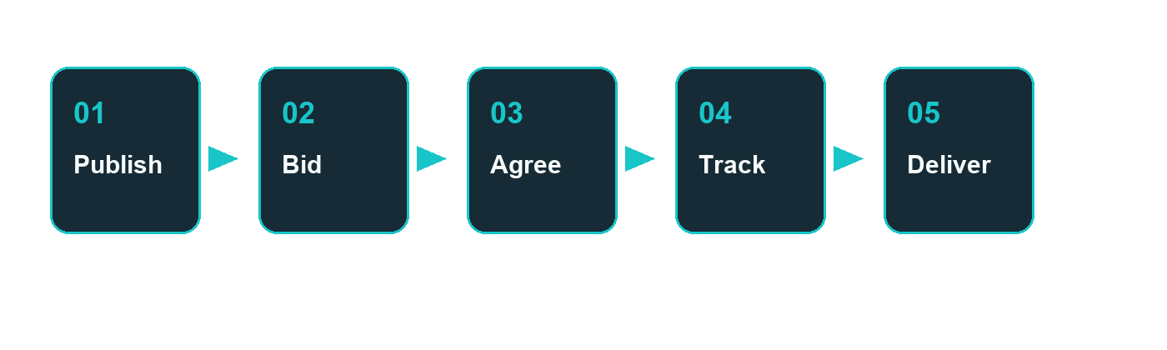
Logivo
03 / 12
THE SOLUTION
One platform from load to delivery
Publish → bid → agree → navigate → track → deliver → rate — all in one product for client and driver.

Slide 4
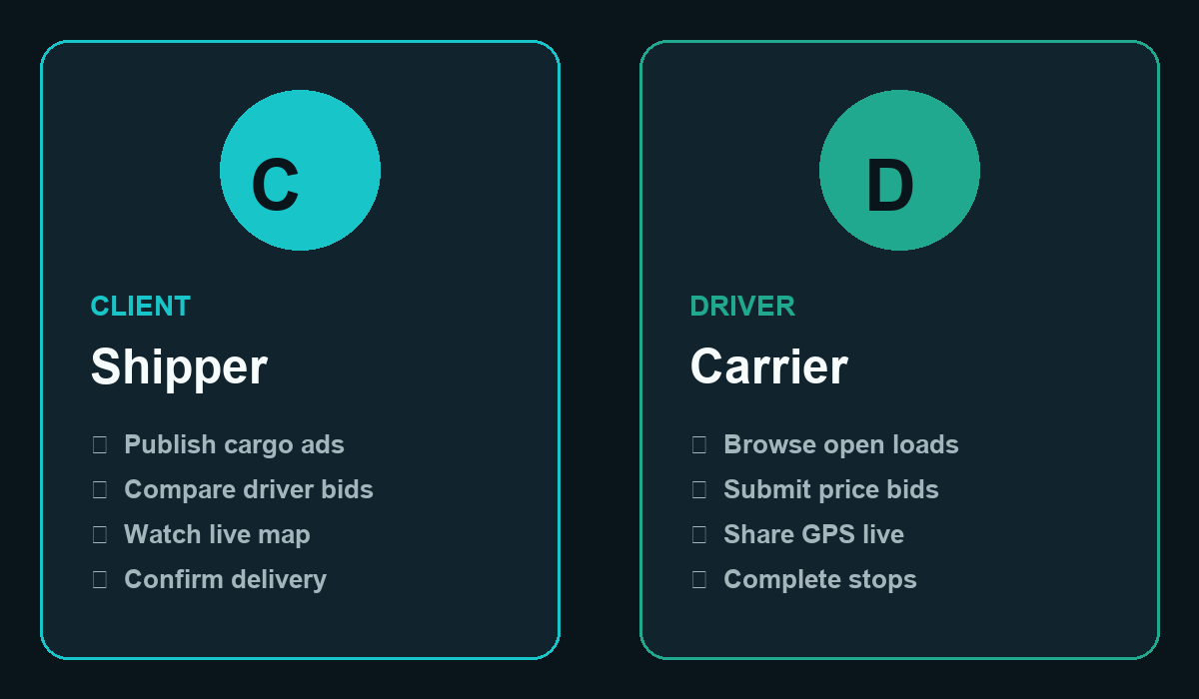
Logivo
04 / 12
WHO IT SERVES
Two roles. One shared trip.
Everything in Logivo is built around the client–driver relationship.

Slide 5
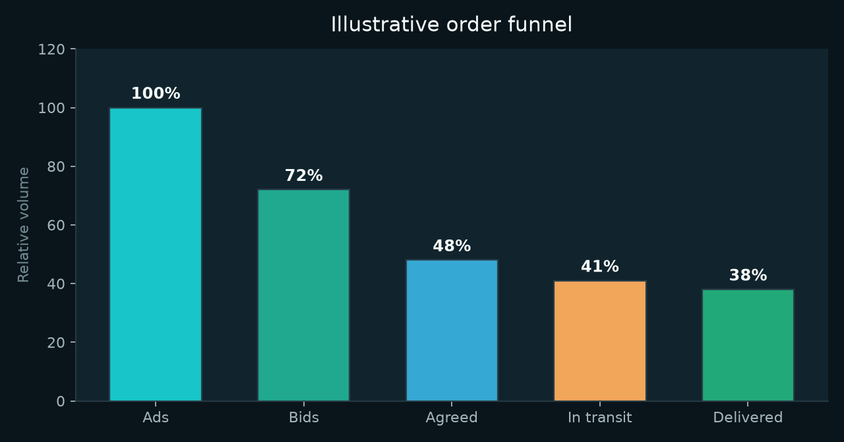
Logivo
05 / 12
HOW IT WORKS
End-to-end order journey
Structured steps instead of ad-hoc messaging — with multi-stop routes, in-app chat, and shareable live links.
Multi-stop routing
Pickup → stops → drop-off.
In-app chat
Tied to the order.
Share link
Read-only live map.
Ratings
Trust after delivery.

Slide 6
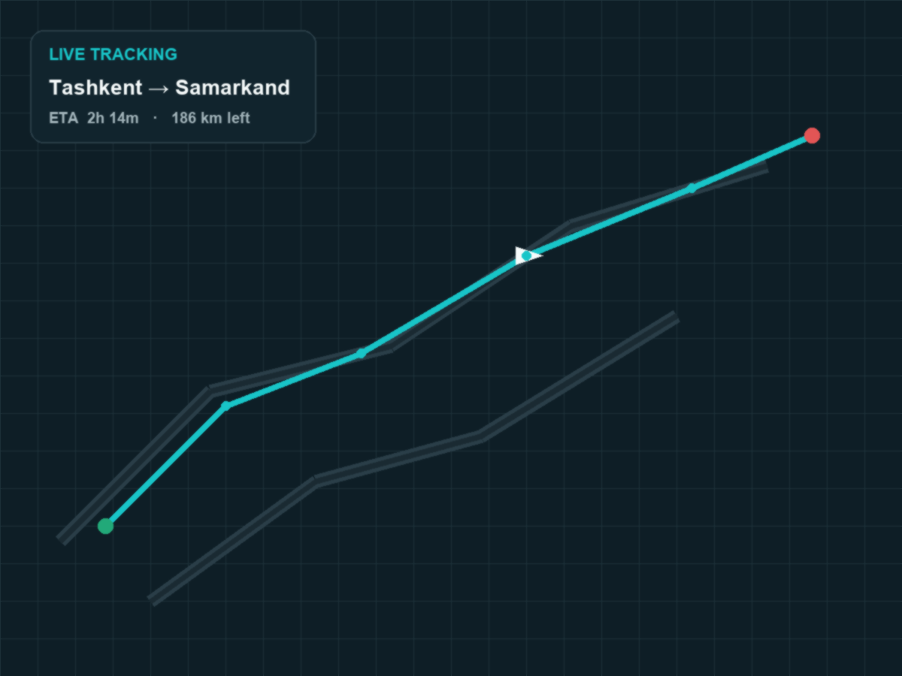
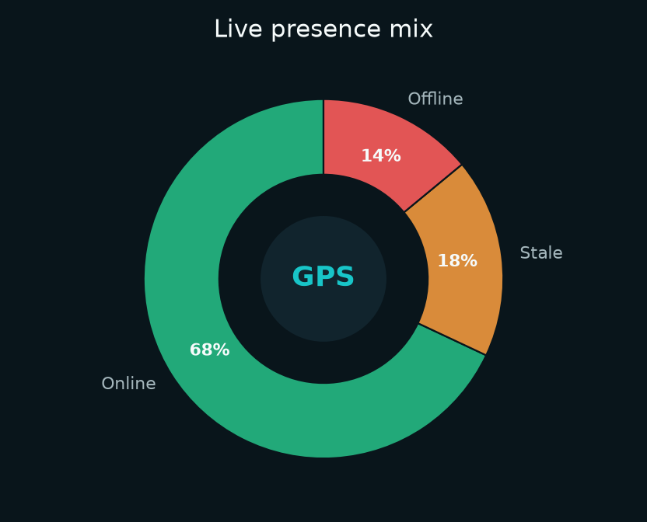
Logivo
06 / 12
LIVE TRACKING
Navigation-grade map experience
MapLibre maps with heading-up camera, smooth markers, background GPS, and presence signals for both sides.
Background GPS
iOS Always + Android FG service
Performance-aware
Lower ticks on older phones

Slide 7
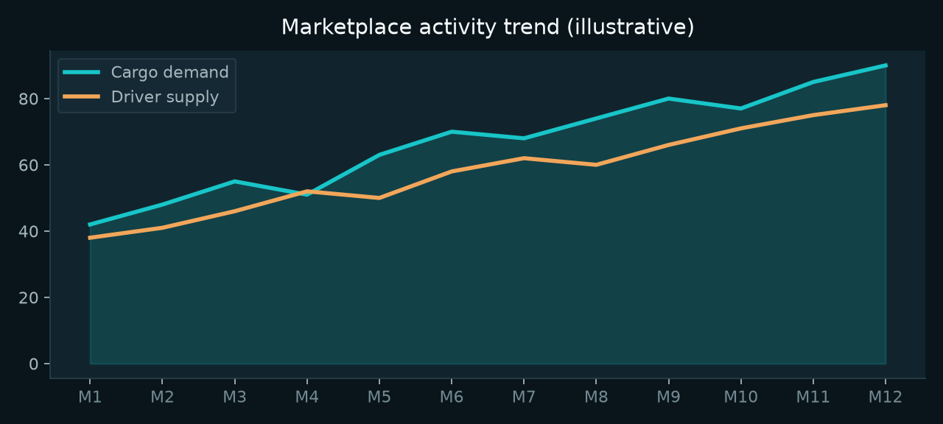
Logivo
07 / 12
MARKETPLACE
Load matching that feels productized
Ads, competitive bids, and lane fit — built for client demand and driver supply.
Ads
Route, cargo, vehicle needs, price insight.
Bids
Drivers offer prices; clients accept.
Fit
Preferred corridors surface faster.

Slide 8

Logivo
08 / 12
TRUST & COMPLIANCE
Documents, reputation, and gates
Driver documents
License, insurance, inspection — with expiry reminders.
Verification
Verified drivers and company INN for organizations.
Trust tiers
Bronze → platinum signals from history.
Custody & SOS
Chain-of-custody events and emergency alerts.

Slide 9
Logivo
09 / 12
MONEY FLOW
Subscriptions, checkout, completion fees
Access
Optional marketplace plans and trials.
Checkout
Click, Payme, Uzum — plus mock mode.
Fees
Platform completion fees after a trip.
Freight payment between client and driver can stay peer-to-peer; Logivo focuses on platform fees and clarity.
Trial
Subscribe
Complete

Slide 10
Logivo
10 / 12
ARCHITECTURE
Mobile + API platform
Mobile
React Native + TypeScript — iOS & Android
API
Django 5 + DRF, OpenAPI docs
Data
PostgreSQL, Redis, Celery
Realtime
Channels — live tracking feeds
Maps
MapLibre + OpenFreeMap tiles
Ops
Docker Compose + GitHub Actions

Slide 11
Logivo
11 / 12
SECURITY & DEMO
Telegram OIDC. Client & driver demos.
New accounts register only through official Telegram OpenID Connect — no Telegram passwords, no chat access.
1 Choose Client or Driver
2 Telegram confirm
3 JWT via ticket
Client demo
Dashboard with active tracking scenario.
Driver demo
Available cargo and full trip workflow.

Slide 12

Logivo
12 / 12
CLOSING
Built for movement.
Designed for control.
Logivo unifies freight marketplace and live execution for clients and drivers — one mobile-first product for Uzbekistan’s logistics market.
Ads
Publish
Bids
Match
GPS
Track
Trust
Rate

